Slide 1
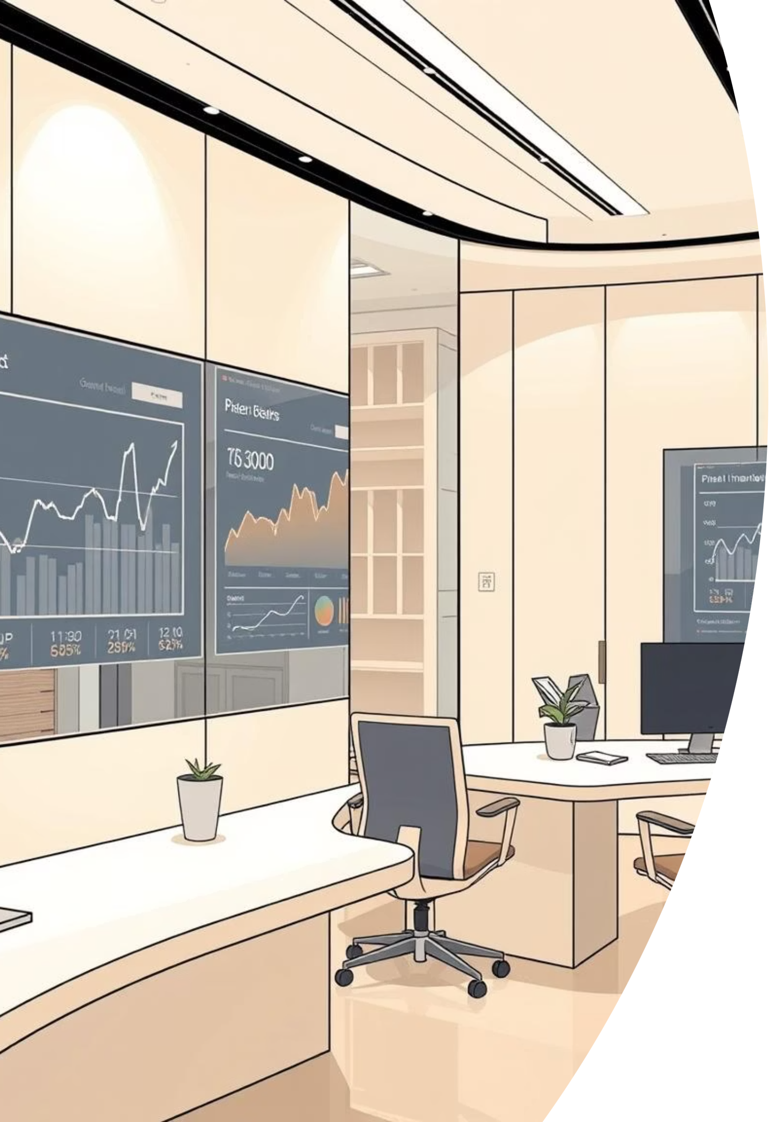
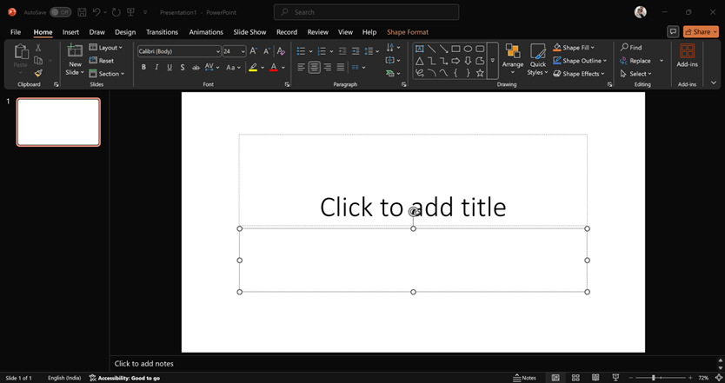
Freelance Income Summary
Welcome to our Freelance Income Summary Report. This presentation provides an in-depth look at our project performance, financial health, and strategic insights across various service lines and regions.

Slide 2
Key Financial Highlights
68
₹145K
₹50K
4.1
Total Projects
Total Revenue
Overdue Amount
Average Rating
A robust portfolio spanning diverse industries and services.
Cumulative income generated from all completed and ongoing projects.
Identified outstanding payments requiring immediate follow-up.
Consistent client satisfaction across our service offerings.

Slide 3
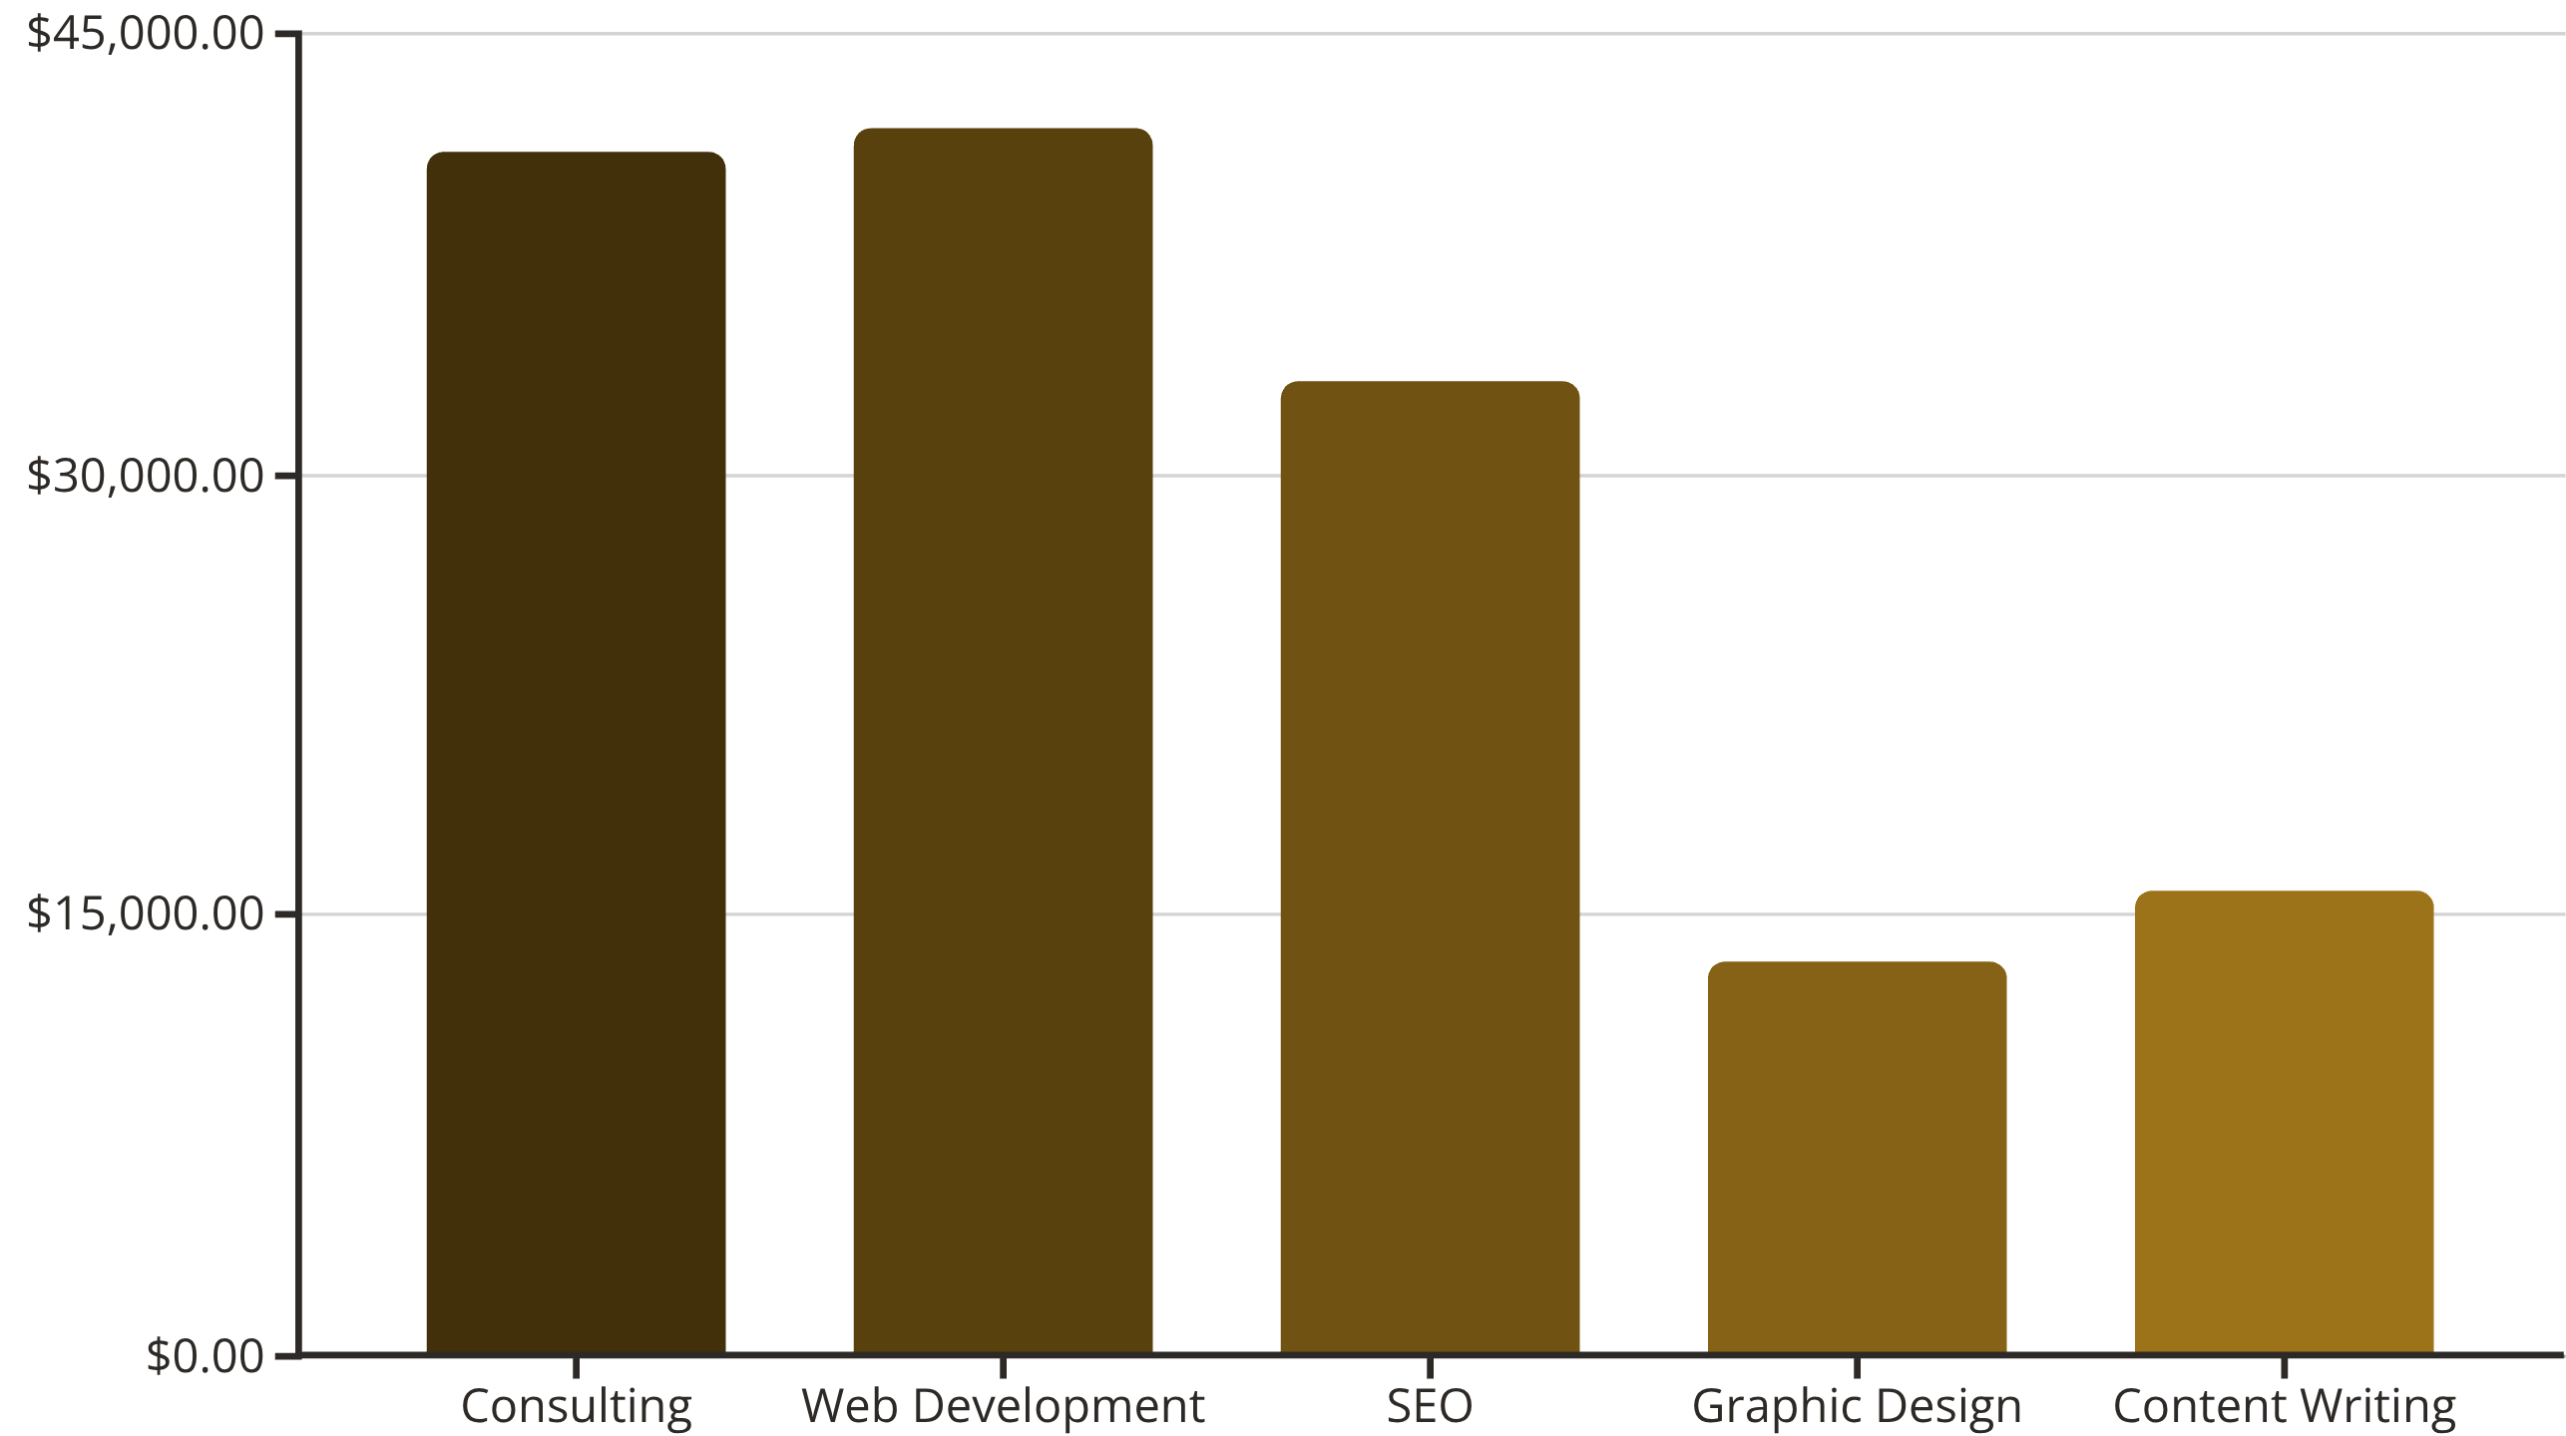
Revenue Breakdown by Service Line
Our top three revenue generators are Consulting, Web Development, and SEO, highlighting key areas of client demand and our core strengths. Graphic Design and Content Writing also contribute significantly to the overall income.

Slide 4
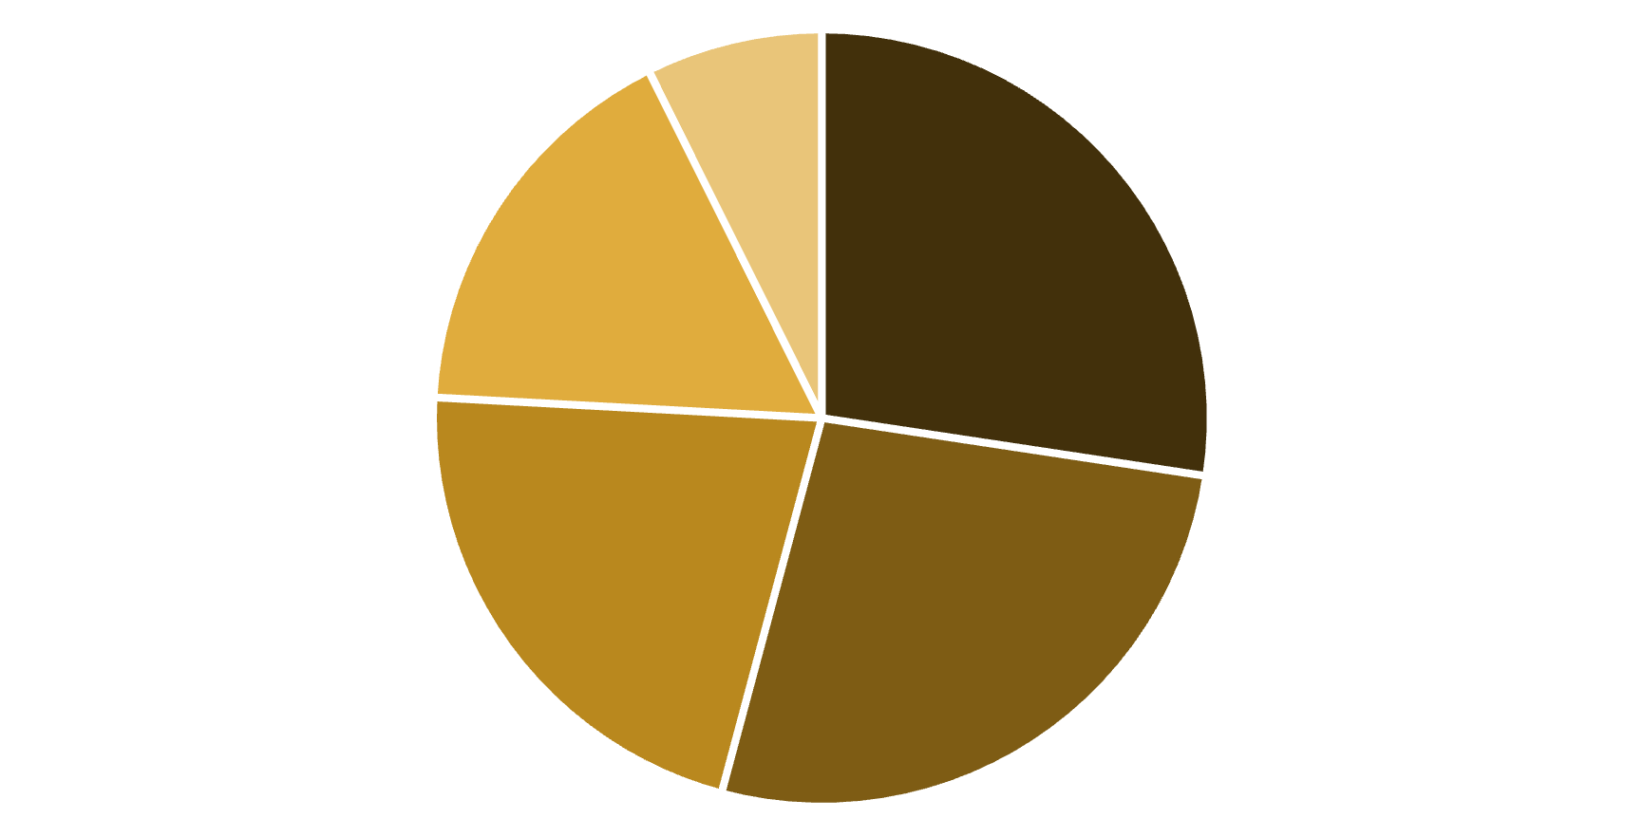
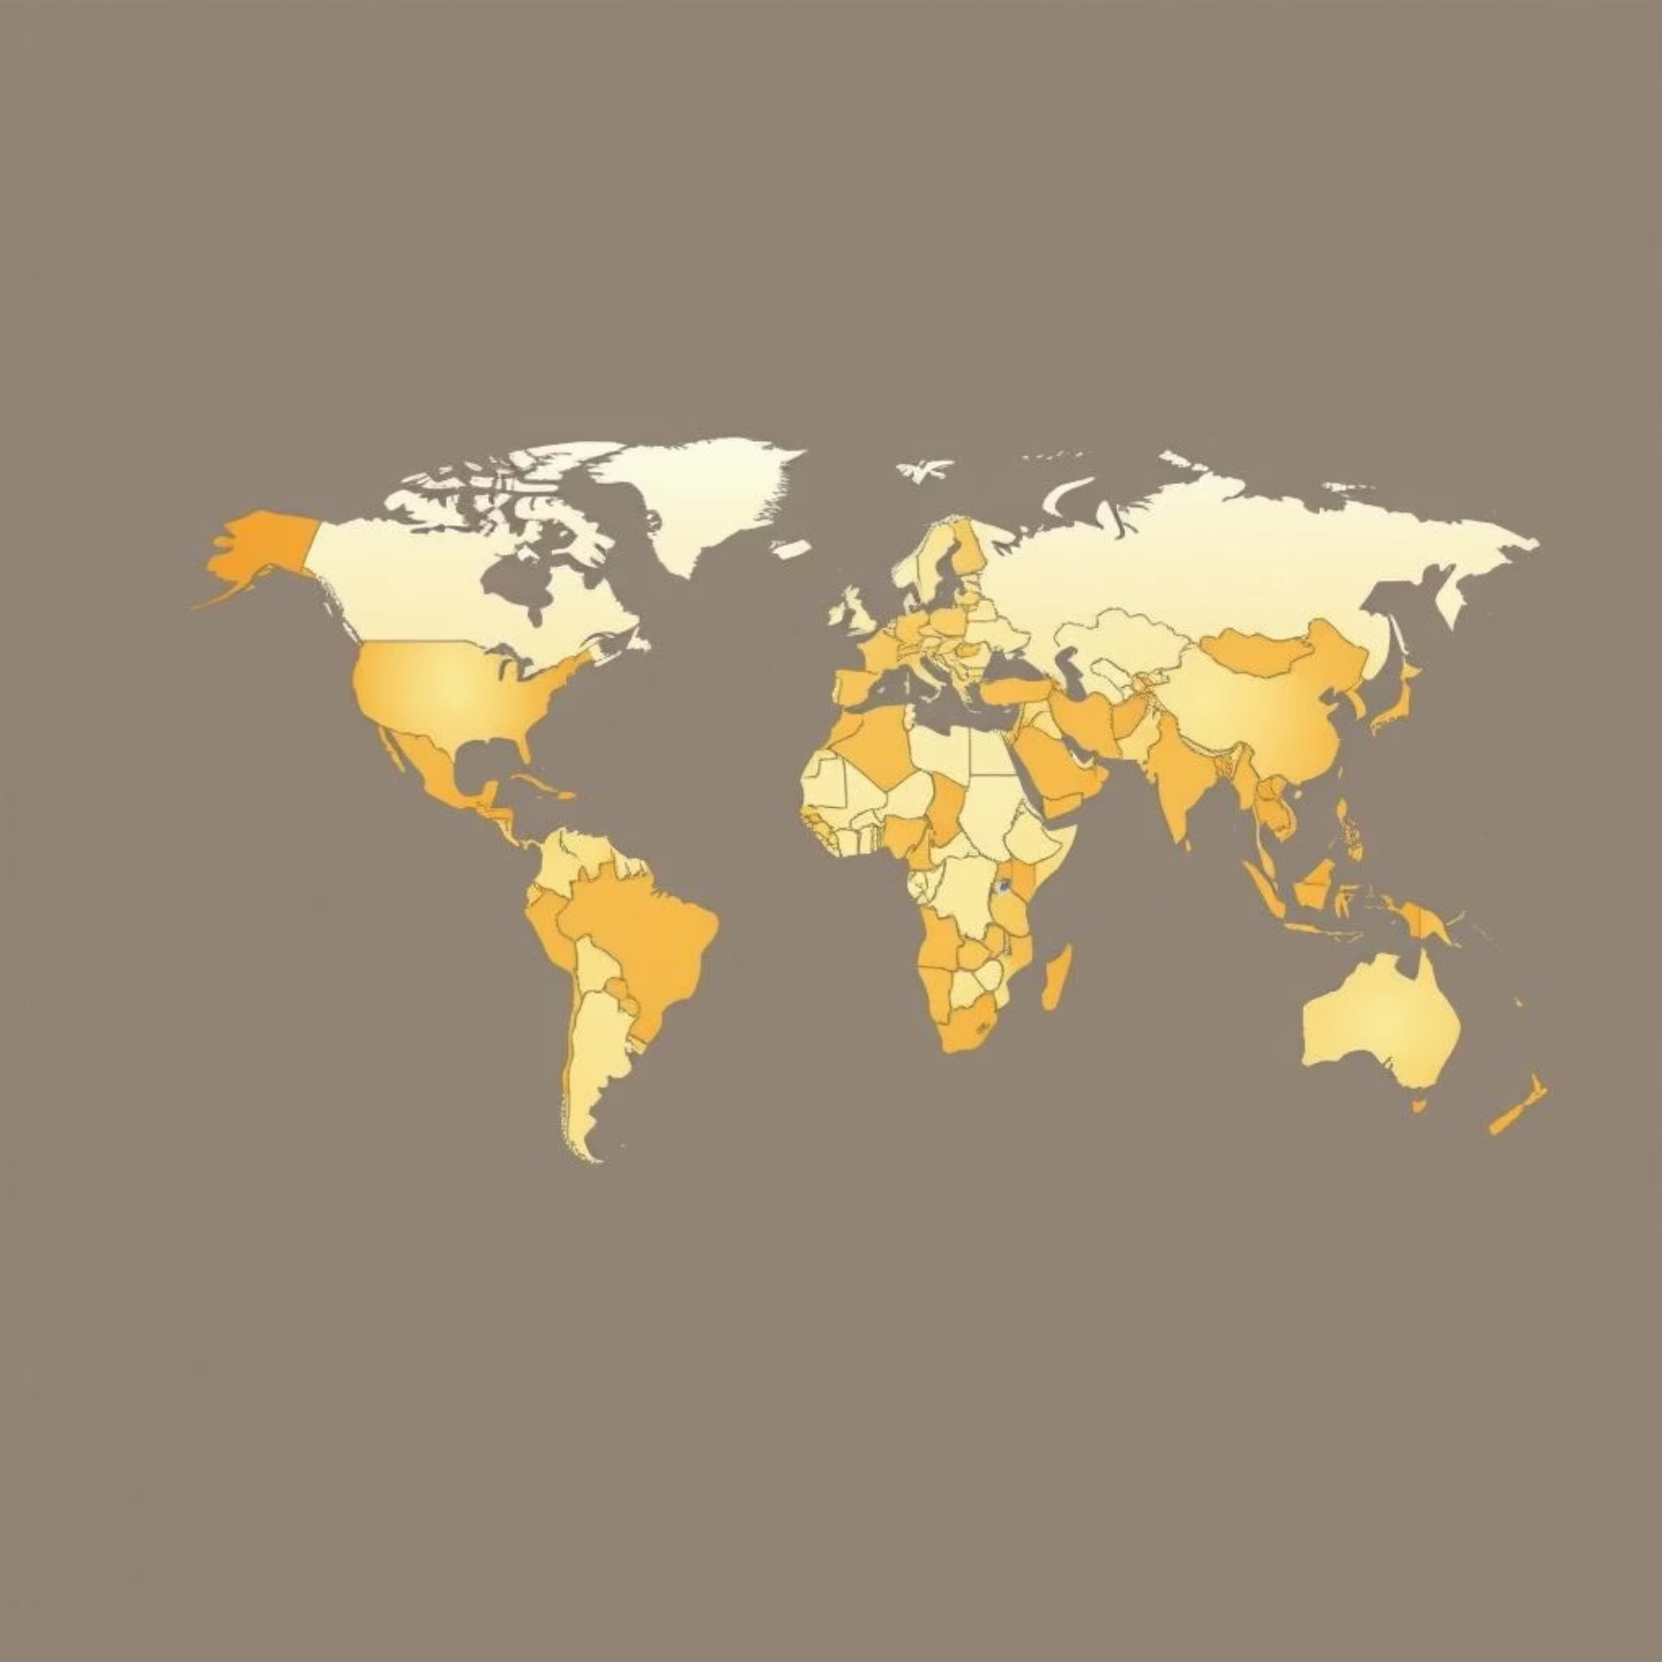
Geographic Revenue Distribution
North America and Europe collectively account for the largest share of our revenue, indicating strong market presence. We see steady contributions from Asia and Australia, while Africa represents an emerging market with growth potential.
North America
Europe
Asia
Australia
Africa

Slide 5







Client Portfolio at a Glance
Our client base includes prominent names in various industries, reflecting the diversity of our service offerings and our ability to cater to different business needs.

Slide 6






Project Status: Paid vs. Overdue
Pending Projects
Total Value: ₹25,820.67 (18% of total)
Paid Projects
Projects awaiting final approval or initial payment.
Overdue Projects
Total Value: ₹85,257.65 (59% of total)
Requires active follow-up for timely conversion.
Total Value: ₹33,962.47 (23% of total)
Prompt and consistent payment from a majority of clients.
Significant amount requires immediate attention.
Ensuring stable cash flow for ongoing operations.
Impacts cash flow and needs structured recovery plan.
While a significant portion of our projects are paid, the overdue amount requires immediate attention to mitigate potential cash flow challenges.

